Slide 1
Wi-Fi Traffic Monitoring System

Slide 2
Wi-Fi Traffic Monitoring System
Notes:
- First chapter we learned different components of network ( nut and bolt of network )
- Second chapter we covered Network Protocol
- Third chapter we will cover a very important layer in network ( Network Layer ) from SDN point of view

Slide 3
Understand the fundamental principles of local WiFi network traffic
Learn a practical method for capturing and analyzing data packets
Explore how traffic monitoring can be used for performance analysis, security, and general network insights
Introduction
Lab setup
Simple dashboard and observation
Advance suggestions
Notes:
Hello, Anyohasye, Namaste
This is Prof Suman Pandey from EECS department GIST
We are learning Advanced Computer Networking
We are now in third modeul
Focusing on SDN archtesure
We learning about Generalized forwarding in prevous module
This module we focus on control plane

Slide 4
Introduction
Wi-Fi Traffic Monitoring
Notes:
- First chapter we learned different components of network ( nut and bolt of network )
- Second chapter we covered Network Protocol
- Third chapter we will cover a very important layer in network ( Network Layer ) from SDN point of view

Slide 5
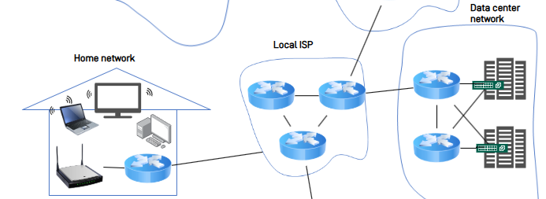
What is Wi-Fi Traffic and Why Monitor it?
What is Wi-Fi Traffic?
The flow of data packets between your devices and the router.
It's the invisible conversation happening on your network.
Why monitor it?
Security: Detect threats & unauthorized devices.
Performance: Find bottlenecks & manage bandwidth.
Troubleshooting: Diagnose connection issues.
source
Re-created illustration

Slide 6
What is a packet? Anatomy of a Data Packet
Every piece of data is sent in a packet, which is like a digital envelop. Each packet has three main parts:
1. Header (The “Mailing Label”)
Contains all the control information for delivery.
Source & Destination Addresses / Protocol / Port Number
2. Payload (The “Letter”)
This is the actual data packets are delivering.
It could be a piece of an email, part of a website, or a second of video.
3. Trailer (The “Seal of Integrity”)
Marks the end of the packet and contains error-checking information.
Frame Check Sequence (FCS): Verifies that the data arrived without being corrupted.

Slide 7


The Central Role of the Router
The Router: Network’s Gateway
The router is the single gateway for all network traffic
All data packets must pass through it, making it the ideal monitoring point.
Our system uses a standard home/office router-no special hardware needed
Router

Slide 8


Core Concepts: How We Capture Traffic
Port Forwarding / Mirroring
A router feature that duplicates all traffic and sends a copy to our monitoring device.
Packet Sniffing
Software on our monitoring device (e.g. Wireshark) that captures and records the copied packets for analysis.
Internet
Router
Packet Capture

Slide 9
The Problem: Limitations of Commercial Routers
Closed Systems
Most commercial routers run vendor-specific OS, making it difficult to install custom software.
Solution: A Mini-PC as a Network “Checkpoint”
Use a Linux-based Mini-PC to act as a transparent router
It sits between your internet source and the existing Wi-Fi router, inspecting all incoming and outgoing traffic
Internet
Router
A Transparent Router Mini-PC

Slide 10
Foundations of Packet Capture
OSI Layers & Capture Points
Application
Presentation
Session
Transport
Network
Data Link
Physical
Application Layer
This is the actual data being sent. (content of a website or a message)
Network & Transport Layers ( <- Scapy’s Primary Domain)
It contains the packet’s IP address and port number.
Scapy are designed to read and manipulate this critical information.
Data Link Layer ( <- Raw Socket Access)
This is the lowest level we can access.
We capture the raw, complete data packet directly from the physical network hardware.

Slide 11
Packet Capture Implementation: Modes & Methods
Our project support three distinct capture modes, defined by their scope and required permissions.
Mode | Implementation Details | Default
Standard Mode | Captures only the traffic to and from the host machine. | Default
Mirror Mode | Captures all traffic on the network | Selectable
Monitor Mode | Captures was 802.11 Wi-Fi frames (requires compatible hardware) | Selectable

Slide 12
Our Project’s Capture Stack & Configuration
Library Stack
System Layer: libpcap (Provides low-level access to the network interface)
Python Binding: Scapy 2.5.0 (Powerful packet manipulation library)
Application layer: PacketCapture Class (Our custom implementation)
Default Configuration
Interface: enp2s0 (Example)
Capture Mode: standard (Normal Mode)
BPF Filter: “net 192.162.100.0/24 or not arp and not icmp6” (Example)
Captures traffic to or from the 192.168.100.x network, ignoring noisy ARP and ICMPv6 packets.
Buffer Size: 65,535 bytes (To capture max-sized packets)

Slide 13
Summary
Why Monitor Traffic?
We monitor the flow of data packets on a network to enhance security, improve performance, and troubleshoot issues.
Our Approach
Since commercial routers are closed systems, we use a Mini-PC as a transparent router to intercept and analyze all traffic
Method
This setup allows us to duplicate (Mirroring) and capture (Sniffing) packets for detailed analysis.

Slide 14
Preliminaries
1. MongoDB
Notes:
- First chapter we learned different components of network ( nut and bolt of network )
- Second chapter we covered Network Protocol
- Third chapter we will cover a very important layer in network ( Network Layer ) from SDN point of view

Slide 15

What is MongoDB?
What is Wi-Fi Traffic?
MongoDB is a modern type of database known as a NoSQL database.
Unlike traditional databases that use tables with rows and columns (like an Excel spreadsheet), MongoDB stores in a more flexible format.
In uses JSON-like documents, which allows it to store complex data structures easily and naturally.
source
Re-created illustration

Slide 16
Core Concepts: Documents & Collections
Documents
The basic unit of data in MongoDB.
A document is a set of field-and-value pairs, very similar to a JSON object.
Example: { “source_ip”: “192.168.1.10”, “protocol”: “TCP”, “size”: 64 }
Collections
A group of documents.
This is similar to a table in a traditional database.
However, a single collection can hold documents with different structures.
source
Re-created illustration

Slide 17
Key Advantage: Schemaless Flexibility
The most significant advantage for our project is that MongoDB is schemaless.
This means that documents within the same collection do not need to have the same fields or structure.
Why is this important for us?
Network packets are not all the same. A TCP packet has different information than a UDP packet.
MongoDB allows us to store all these different types of packets in the same packet collection without any issues.
source
Re-created illustration

Slide 18
Why MongoDB for Our Project?
We chose MongoDB for our traffic monitoring system for two main reasons:
High Performance
The system needs to capture and save thousands of packets per second. MongoDB is designed to handle this high volume of write operations very quickly and efficiently.
Scalability
As we capture more and more network traffic, our database will grow very large. MongoDB an easily scale across multiple servers to handle massive amounts of data without slowing down.
source
Re-created illustration

Slide 19
Preliminaries
2. Security for Web
Notes:
- First chapter we learned different components of network ( nut and bolt of network )
- Second chapter we covered Network Protocol
- Third chapter we will cover a very important layer in network ( Network Layer ) from SDN point of view

Slide 20
The Problem: Insecure HTTP
The standard protocol for the web is HTTP (Hypertext Transfer Protocol).
The biggest problem with HTTP is that all data is sent in plaintext.
This means that if someone intercepts the traffic between your browser and the server, they can read everything—usernames, passwords, and all other sensitive information. This is not secure.
source
Re-created illustration

Slide 21
The Solutions: HTTPS
To solve this problem, we use HTTPS (Hypertext Transfer Protocol Secure)
HTTPS is simply a secure layer added to HTTP. It encrypts all the data.
This encryption ensures that even if the traffic is intercepted, it just looks like random, scrambled nonsense to anyone without the decryption key. It protects the confidentiality and integrity of our data.
source
Re-created illustration

Slide 22
How to Enable HTTPS: SSL/TLS Certificates
To use HTTPS, a web server needs a digital certificate called an SSL/TLS Certificate.
What it does:
Authentication: It proves the identity of the server, so you know you are connecting to the correct website and not an imposter.
Encryption: It contains the public key that the browser uses to set up a secure, encrypted channel with the server.
Who issues them?
For public websites, these certificates are issued by trusted Certificate Authorities (CAs).
source
Re-created illustration

Slide 23
HTTPS in Our Lab: Self-Signed Certificates
In our lab, we don’t need a certificate from a public CA. Instead, we generate a self-signed certificate.
What this means:
It provides the exact same level of encryption as a certificate from a CA. The connection is fully secure.
However, because it's not signed by a trusted authority, your web browser will show a warning like "Your connection is not private".
This warning is expected and perfectly fine for our internal lab environment. We can safely click "Advanced" and proceed to the site.
source
Re-created illustration

Slide 24
Preliminaries
2-1. SSL/TLS
Notes:
- First chapter we learned different components of network ( nut and bolt of network )
- Second chapter we covered Network Protocol
- Third chapter we will cover a very important layer in network ( Network Layer ) from SDN point of view

Slide 25
SSL & TLS: A Secure Tunnel for the Internet
SSL (Secure Sockets Layer) and TLS (Transport Layer Security) are security protocols that encrypt internet communications to keep them safe and private.
Simply put, you can think of them as a technology that creates a secure tunnel between two computers, preventing anyone from eavesdropping on the conversation. This technology is the core of what makes HTTPS secure.
source
Re-created illustration

Slide 26
The Three Core Functions of SSL/TLS
This technology protects our communications by performing three key functions:
Encryption (Confidentiality)
It scrambles the data being exchanged into a secret code, making it unreadable to anyone who might intercept it. This prevents the exposure of sensitive information.
Integrity
It guarantees that the data has not been altered or corrupted during transmission. This is like a tamper-proof seal on a letter.
Authentication
It verifies the identity of the server you are connecting to, ensuring it is legitimate and not an imposter. The SSL/TLS Certificate acts as a digital ID to prove the website's identity.
source
Re-created illustration

Slide 27
SSL vs. TLS: What’s the Difference?
While they serve the same purpose, they are different versions of the technology.
SSL (Secure Sockets Layer)
This is the predecessor and the original version.
It is now considered outdated and insecure due to known security vulnerabilities and is no longer used.
TLS (Transport Layer Security)
This is the successor and the current industry standard.
It is a more secure and improved version that fixes the vulnerabilities found in SSL.
source
Re-created illustration

Slide 28
Preliminaries
2-2. Expiration Key
Notes:
- First chapter we learned different components of network ( nut and bolt of network )
- Second chapter we covered Network Protocol
- Third chapter we will cover a very important layer in network ( Network Layer ) from SDN point of view

Slide 29
Securing Access: Timed Sessions
Encrypting the connection is only the first step. We also need to ensure that a user's login session is secure and doesn't last forever.
We achieve this using auto-expiring access keys (also known as tokens).
Instead of keeping a user logged in indefinitely, the server gives the user a temporary key that is only valid for a specific period (e.g., 8 hours).
This greatly enhances security because even if an attacker manages to steal a key, it will become useless once it expires.
source
Re-created illustration

Slide 30
Mechanism: How Auto-Expiring Keys Work
Here is the step-by-step process:
Login: The user provides their username and password.
Key Generation: The server verifies the credentials. If they are correct, it generates a unique, digitally signed key.
Set Expiration: The server embeds an expiration timestamp directly into the key itself.
Verification: With every action the user takes, their browser sends the key back to the server. The server checks two things:
- Is the signature valid? (To prevent tampering)
- Has the key expired?
Access Denied on Expiry: If the current time is past the key's expiration timestamp, the key is rejected. The user is automatically logged out and must log in again to get a new, valid key.
source
Re-created illustration

Slide 31
Lab Setup
Notes:
- First chapter we learned different components of network ( nut and bolt of network )
- Second chapter we covered Network Protocol
- Third chapter we will cover a very important layer in network ( Network Layer ) from SDN point of view

Slide 32
Prerequisites
This lab is designed to run in a Linux-based environment (e.g., Ubuntu, etc.)
Install: python3-pip, nginx, hostapd, dnsmasq, iptables-persistent
Python: The core programming language for our capture scripts.
pip: The package installer for managing Python libraries (e.g., Scapy, Pymongo).
MongoDB: A NoSQL database used to store and query captured packet data.
Nginx: A lightweight web server for hosting the analysis dashboard.

Slide 33
Step 1: MongoDB
1. Import the MongoDB GPG Key
curl -fsSL https://pgp.mongodb.com/server-7.0.asc | sudo gpg -o /usr/share/keyrings/mongodb-server-7.0.gpg --dearmor
2. Add the MongoDB Repository
echo "deb [ arch=amd64,arm64 signed-by=/usr/share/keyrings/mongodb-server-7.0.gpg ] https://repo.mongodb.org/apt/ubuntu $(lsb_release -cs)/mongodb-org/7.0 multiverse" | sudo tee /etc/apt/sources.list.d/mongodb-org-7.0.list

Slide 34
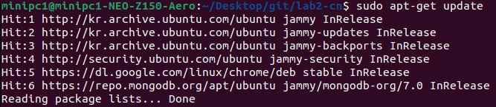
Step 2: Install
3. Update Local Package List
sudo apt-get update
4. Install All Required Packages
sudo apt-get install -y python3-pip mongodb-org nginx hostapd dnsmasq iptables-persistent

Slide 35
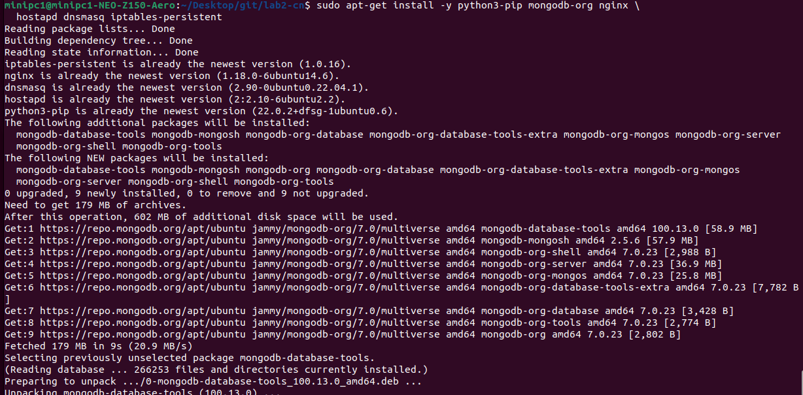
Step 2: MongoDB

Slide 36

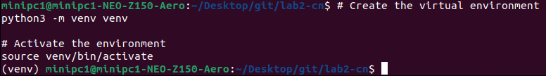
Step 3: Python Virtual Env.
1. Install python3-venv
sudo apt-get install –y python3-venv
2. Create & Activate the Environment
Python3 –m venv venv
Source venv/bin/activate
Virtual Env. is activated.

Slide 37
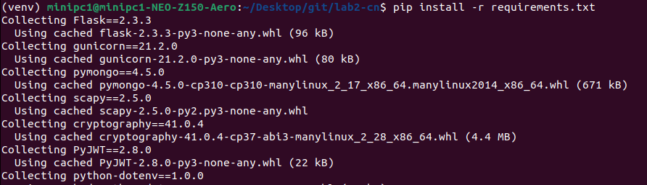
Step 3: Python Virtual Env.
With the virtual env. active, install all the required Python libraries (like Flask, Scapy, etc.) using the requirements.txt file
3. Install Python Dependencies
pip install -r requirements.txt

Slide 38

Step 4: Start & Enable MongoDB
1. Start and Enable the Service
sudo systemctl start mongod
sudo systemctl enable mongod

Slide 39
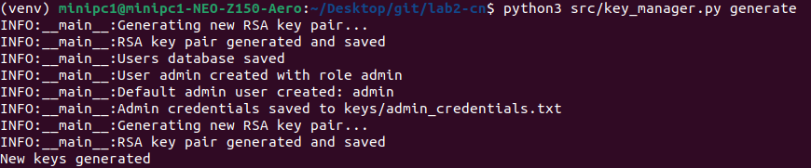
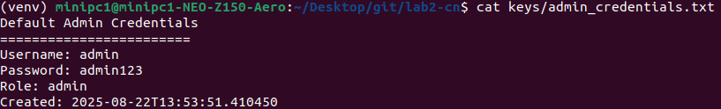
Step 5: Generate Keys
1. Generate Security Key & Admin Account
python3 src/key_manager.py generate
2. Check Password
cat keys/admin_credentials.txt

Slide 40
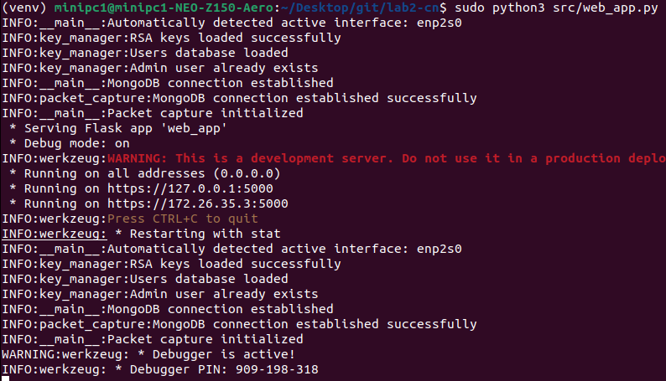
Step 6: Run Application
1. Run the Web Application
sudo python3 src/web_app.py
Ctrl+{Click}

Slide 41
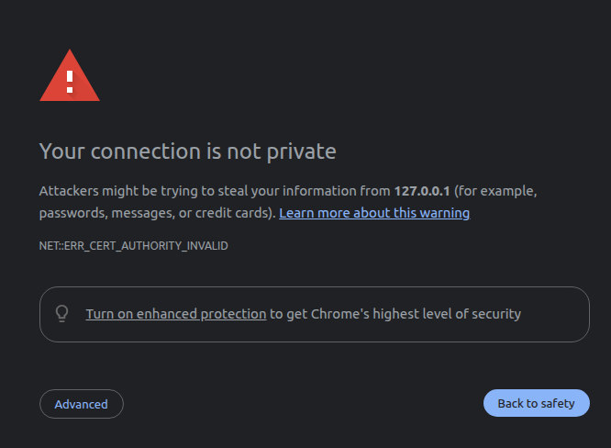
Step 6: Access to the Webpage
1. Run the Web Application
Click

Slide 42
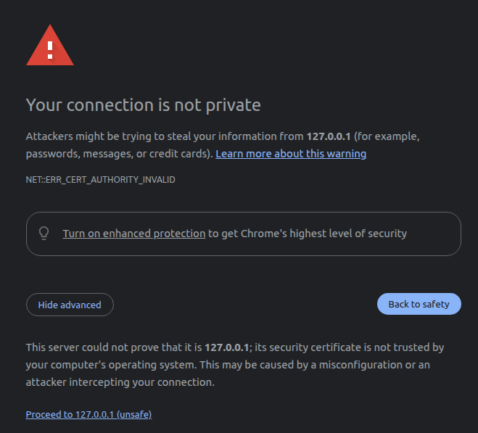
Step 6: Access to the Webpage
Click

Slide 43
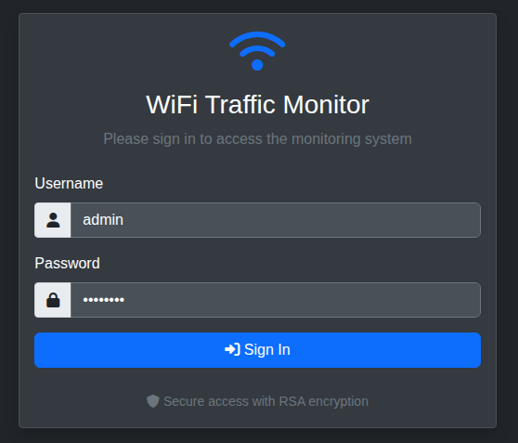
Step 6: Access to the Webpage
1. Log in with Username & Password
Username: admin
Password: admin123
Now, let’s dive into the detailed features of the tool and how to use them in next section.

Slide 44
Simple Dashboard and Observation
Notes:
- First chapter we learned different components of network ( nut and bolt of network )
- Second chapter we covered Network Protocol
- Third chapter we will cover a very important layer in network ( Network Layer ) from SDN point of view

Slide 45

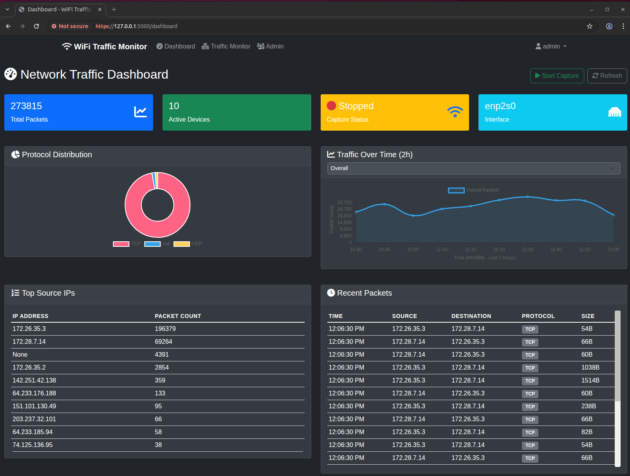
Dashboard Overview: Visualizing Network Traffic
Start Button for
Packet Capturing
Menu
Main Contents of Dashboard

Slide 46
Three Key Features: A Quick Tour
Dashboard
A visual summary page to understand the network’s overall status and traffic patterns at a glance through graphs and charts.
Traffic Monitor
A detailed investigation tool to troubleshoot network issues by searching and analyzing specific packets with filtering.
Admin Panel
An admin-only page to control user access and manage the system’s overall status and security.

Slide 47
Simple Dashboard and Observation
- Dashboard -
Notes:
- First chapter we learned different components of network ( nut and bolt of network )
- Second chapter we covered Network Protocol
- Third chapter we will cover a very important layer in network ( Network Layer ) from SDN point of view

Slide 48
A Snapshot of Network’s Health
The top panel offers a real-time summary of the network’s critical information
Total Packets
The cumulative count of all captured packets.
Active Devices
Shows the number of unique devices currently sending or receiving data.
Capture Status & Interface
Clearly indicates if the monitoring system is currently running (Status) and which network card (interface) is being monitored.

Slide 49
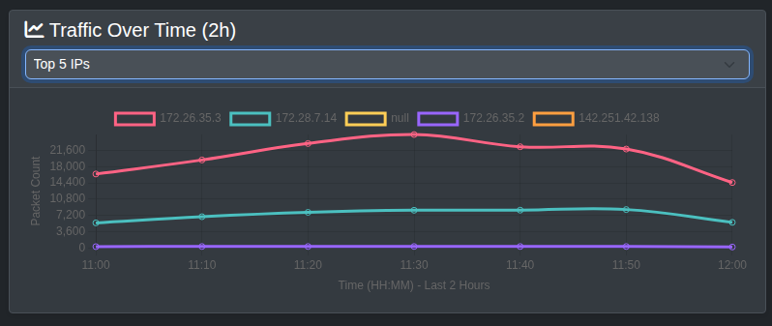
Traffic Patterns: What Kind and When?
Protocol Distribution
This donut chart shows the proportion of different protocols, like TCP and UDP.
It helps you understand the primary purpose of the network’s usage, whether it’s for web browsing (TCP) or for video streaming and gaming (UDP).
Traffic Over Time
This line graph displays the trend of traffic volume over a specific period.
It’s essential for identifying the network’s busiest periods and spotting anomalies, such as sudden and unexpected traffic spikes.

Slide 50
Detailed Analysis: Who is Talking and What Are They Saying?
Top Source Ips
This table ranks the IP addresses that have generated the most packets on the network.
It allows you to identify which devices are consuming the most bandwidth.
Recent Packets
A real-time log of captured packets, displayed chronologically with details like source, destination, protocol, and size.
This provides the most granular and specific data.

Slide 51
Simple Dashboard and Observation
- Traffic Monitor -
Notes:
- First chapter we learned different components of network ( nut and bolt of network )
- Second chapter we covered Network Protocol
- Third chapter we will cover a very important layer in network ( Network Layer ) from SDN point of view

Slide 52
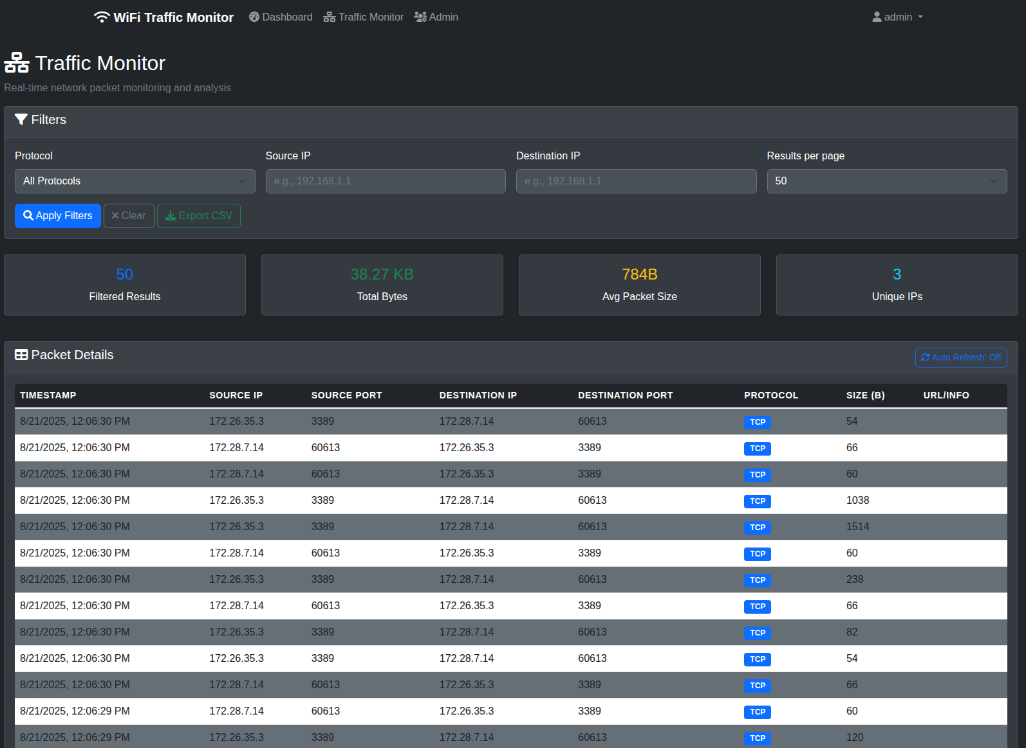
Traffic Monitor: Deep Packet Inspection
The Traffic Monitor page is an interactive tool for detailed, real-time analysis of captured packets.
Unlike the main dashboard which provides a summary, this view allows you to filter, search, and drill down into specific network conversations for in-depth investigation and troubleshooting.

Slide 53
Traffic Monitor: Deep Packet Inspection
Filters:
Allows you to pinpoint specific data flows.
You can search by Protocol, Source IP, and Destination IP.
Exporting:
Enables offline analysis and reporting.
The “Export CSV” feature allows you to save your filtered results, making it easy to share data or perform further analysis in other tools like Excel.

Slide 54
Simple Dashboard and Observation
- Admin Panel -
Notes:
- First chapter we learned different components of network ( nut and bolt of network )
- Second chapter we covered Network Protocol
- Third chapter we will cover a very important layer in network ( Network Layer ) from SDN point of view

Slide 55
Traffic Monitor: Deep Packet Inspection
The Traffic Monitor page is an interactive tool for detailed, real-time analysis of captured packets.
Unlike the main dashboard which provides a summary, this view allows you to filter, search, and drill down into specific network conversations for in-depth investigation and troubleshooting.

Slide 56
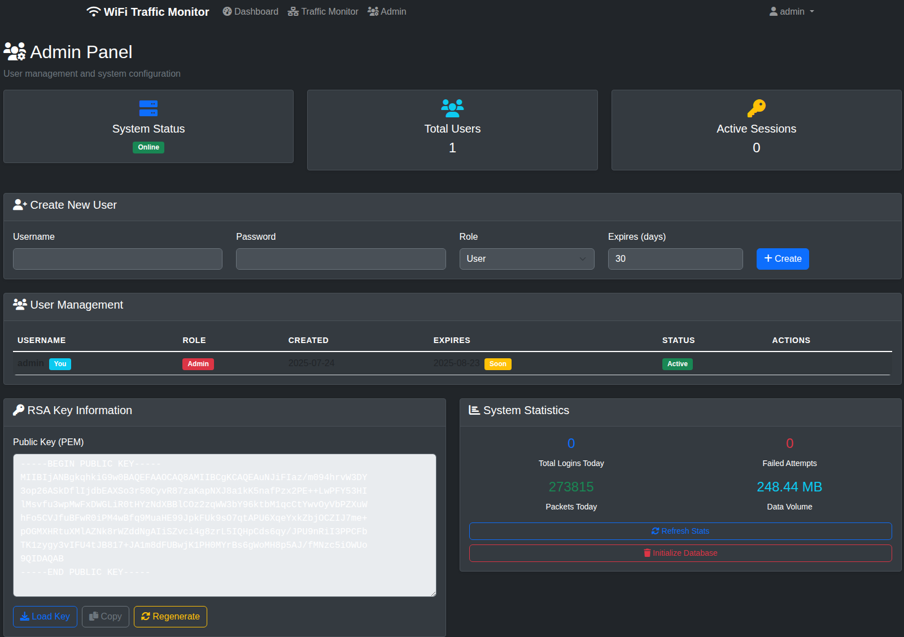
Admin Panel – System & User Management
The Admin Panel is the central hub for system configuration and security, separate from the traffic analysis dashboard.

Slide 57
Traffic Monitor: Deep Packet Inspection
Create New User:
Allows the administrator to create new user accounts.
You can define a Username, Password, assign a Role and set an expiration date for the account.
User Management Table:
Provides a comprehensive list of all existing users.

Slide 58
Traffic Monitor: Deep Packet Inspection
RSA Key Information:
Manages the public key for secure communication.
This is an advanced security feature, likely used to secure API connections or ensure encrypted communication between monitoring components.
System Statistics:
Offer a high-level overview of the system’s health.
You can quickly see the online status and statistics of the system.
You can also initialize the database.

Slide 59
Advanced Suggestion
Intelligent Network Monitoring
Notes:
- First chapter we learned different components of network ( nut and bolt of network )
- Second chapter we covered Network Protocol
- Third chapter we will cover a very important layer in network ( Network Layer ) from SDN point of view

Slide 60
Future Enhancements: Intelligent Network Monitoring with AI & LLM
Our current system provides a robust foundation for advanced network analysis.
By integrating AI and Large Language Models (LLMs), we can unlock powerful new capabilities.
1. Intelligent Threat Detection
Anomaly Detection
Proactive Defense
2. Content-Based Filtering & Blocking
Harmful Website Detection
Time-Based Access Control
3. Predictive Network Management
Bandwidth Prediction
Automated Troubleshooting
4. Enhanced Network Insights & Reporting
User Behavior Analysis
Natural Language Reporting

